Slide 1
ICMTC SATELLITE CHALLENGE · SATC-6 · TASK II
Coarse Sun Sensor
Critical Design Review
Team Name: AAST NOVA
Roles: Electronics & Firmware · Software & GUI · Integration & Test
2026

Slide 2
R O A D M A P
Agenda
01
Mission & Requirements
05
Firmware
Sensor role, mandatory minimums, and our competition strategy
ESP32 firmware architecture and control logic
02
PCB Design
GUI
06
Board layout, routing, and component placement decisions
Python/PyQt5 operator interface and telemetry display
03
Components
07
Future Trends
Key hardware selections across the signal chain
Calibration, ML-based enhancements, and next steps
04
End-to-End Architecture
Full system view from photodiodes to ground display
Coarse Sun Sensor CDR

Slide 3
MISSION CONTEXT
Role of a Coarse Sun Sensor
Without knowing where the sun is, a satellite can lose power, overheat, or lose control entirely.
1. Attitude Determination: The primary mission is to tell the spacecraft where the Sun is relative to its body.
2.Attitude control: Orienting the satellite so it points to the desired aim. For solar panels, antennas, pointing cameras
3. Safe Mode Recovery: the satellite's last-resort failsafe when other systems fail
4.Protecting Sensitive Instruments: Some cameras, telescopes, and scientific instruments can be damaged by direct sunlight or high temperature.
±80° FIELD OF VIEW
(mandatory minimum: ±60°)
Coarse Sun Sensor CDR

Slide 4
DESIGN TARGETS
Requirements & Competition Strategy
Our strategy targets bonus-scoring performance, not just minimum compliance. Every headline spec is designed with margin above the mandatory floor.
Parameter | Mandatory Minimum | Our Design Target | Margin
Field of View | ±60° | ±80° | +33%
Update Rate | 5 Hz | 10 Hz | 2×
Sun Channels | 1 axis | 4 photodiodes (2-axis) | Full coverage
Thermal Monitoring | Not required | Dual DS18B20 sensors | Added robustness
Coarse Sun Sensor CDR

Slide 5
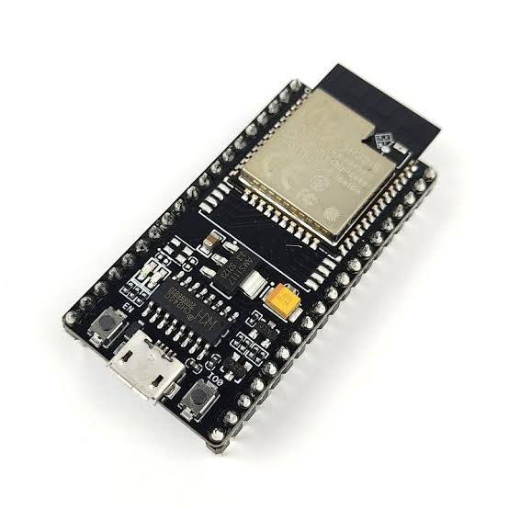
System Design
Components
1. ESP32-S (Microcontroller)
Controls the entire sun sensor system
Reads ADC data via I²C
Polls temperature sensors
Executes sun-detection algorithm
Controls status LEDs
Sends telemetry to the GUI
Advantages
Dual-core processor for fast data processing
Built-in Wi-Fi and Bluetooth
Large number of GPIO pins
Low cost.
Extensive Arduino library support
Coarse Sun Sensor CDR

Slide 6
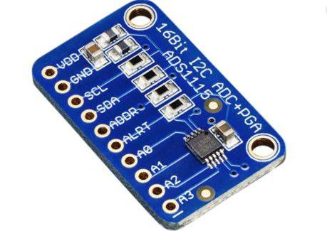
System Design
Components
2. ADS1115 (16-bit ADC)
Converts amplified photodiode voltages into digital values
Transfers data to the ESP32 via I²C
Advantages
High 16-bit resolution for accurate measurements
Built-in Programmable Gain Amplifier (PGA)
Simple I²C interface (SDA & SCL)
Multiple selectable I²C addresses
Low-noise performance
Coarse Sun Sensor CDR

Slide 7
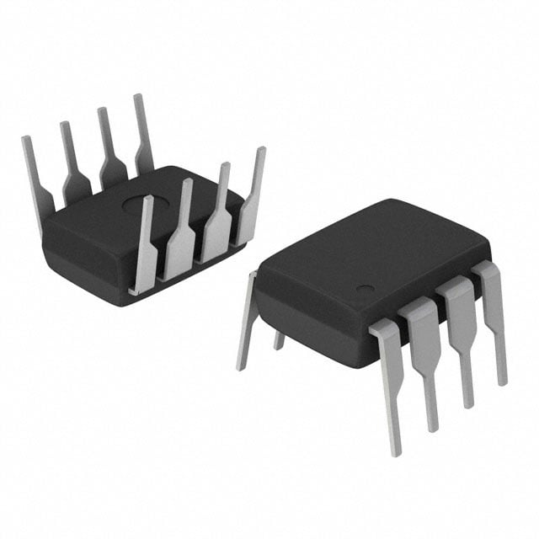
System Design
Components
3. LM358P (Dual Operational Amplifier)
Implements the Transimpedance Amplifier (TIA)
Converts photodiode current into measurable voltage
Advantages
Two op-amps in one package
Operates from a single power supply
Low power consumption
Low cost
Suitable for low-speed sensor applications
Coarse Sun Sensor CDR

Slide 8
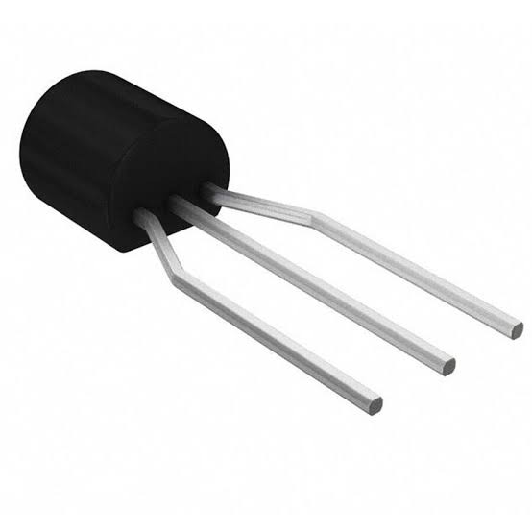
System Design
Components
4. DS18B20 (Digital Temperature Sensor)
Measures temperature
Provides thermal monitoring and calibration data
Advantages
Digital output (no analog conditioning required)
High accuracy (±0.5°C)
OneWire interface reduces wiring
Unique factory-programmed ID for each sensor
Low power and compact size
Coarse Sun Sensor CDR

Slide 9
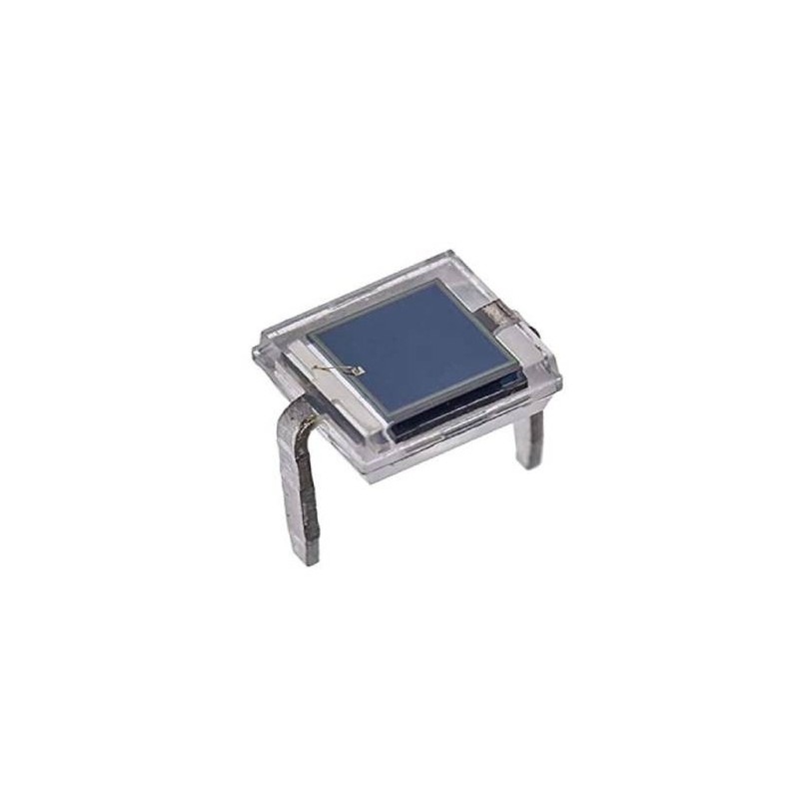
System Design
Components
5. BPW34 (Silicon Photodiode)
Detects sunlight
Converts incident light into photocurrent
Provides four sensing channels for angle estimation
Advantages
Wide spectral response (Visible (430 to 680 nm)+ Near-IR (1100 nm))
Fast response time
Low cost
Easy to integrate into sensor arrays
Stable and well-characterized performance
Coarse Sun Sensor CDR

Slide 10
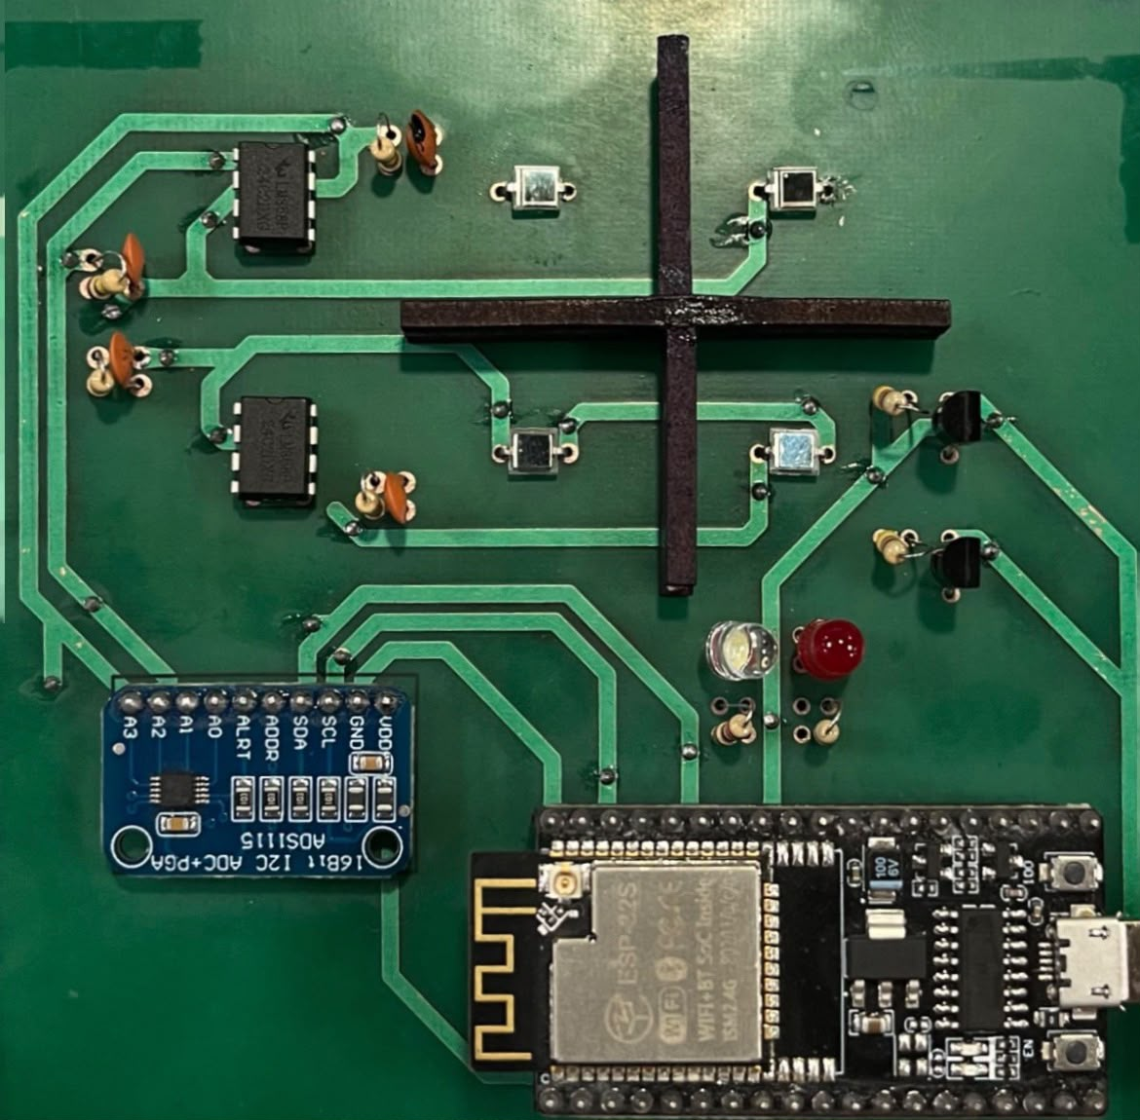
System Design
Cross-shaped wall
Separates the four photodiodes to limit each sensor's field of view.
Reduces stray light and optical crosstalk.
Improves angle estimation accuracy.
Enables the required field of view (up to ±80° depending on the geometry).
The equation used is θ=tan−1(d/h​)
Dimensions 50*50mm
Wall thickness 2mm
Wall height 8mm
Quadrant size 24x24
Coarse Sun Sensor CDR

Slide 11





SYSTEM DESIGN
End-to-End System Architecture
4× BPW34
Photodiodes
TIA Stage
LM358P
ADS1115
16-bit ADC
ESP32-S
MCU
Python GUI
(Ground)
Silicon sun-angle sensing
Inverting transimpedance amp
I²C, GPIO21/22 · 0x48
Acquisition & control
Real-time visualization
2× DS18B20 Temp Sensors + Status LEDs (Green / Yellow)
Signal flows left to right: analog sun-angle sensing, conditioning, digitization, onboard processing, then wireless/serial reporting to the ground GUI.
Coarse Sun Sensor CDR

Slide 12
HARDWARE · ANALOG FRONT END
Photodiode Array & Signal Conditioning
4× BPW34 Silicon Photodiodes
PER-CHANNEL SIGNAL CHAIN
Arranged for multi-axis sun-angle discrimination; wide spectral response in the visible/near-IR band matches solar irradiance.
Photodiode
(BPW34)
Inverting TIA
(LM358P)
Inverting Transimpedance Stage
Each photodiode feeds a dedicated inverting TIA, converting photocurrent to a clean, amplified voltage.
Feedback R + C
Dual LM358P Op-Amps, Feedback resistor + 12 pF Compensation
Buffered
Output Voltage
Low-power dual op-amps set gain via 100 kΩ feedback resistors, with a 12 pF capacitor in parallel across each feedback resistor to limit bandwidth and suppress high-frequency noise/oscillation — balancing sensitivity against noise and saturation margin.
Gain per channel is fixed by the 100 kΩ feedback resistor, with the parallel 12 pF capacitor stabilizing the response — giving predictable, repeatable calibration across all four sensing channels.
Coarse Sun Sensor CDR

Slide 13


HARDWARE · HOUSEKEEPING
Thermal Monitoring & Status Indication
2× DS18B20 Digital Sensors
OneWire bus on GPIO4 and GPIO5 with a 4.7 kΩ pull-up resistor. Dual placement tracks thermal gradients across the sensor board — not required by the competition, but added for robustness.
White Status LED
Illuminates during sun presence.
Red Status LED
Illuminates when the temperature is greater than 30, giving an at-a-glance operational check without the GUI.
Resistors: 220 Ω current-limiting on each status LED · 4.7 kΩ pull-up on the OneWire temperature bus.
Coarse Sun Sensor CDR

Slide 14
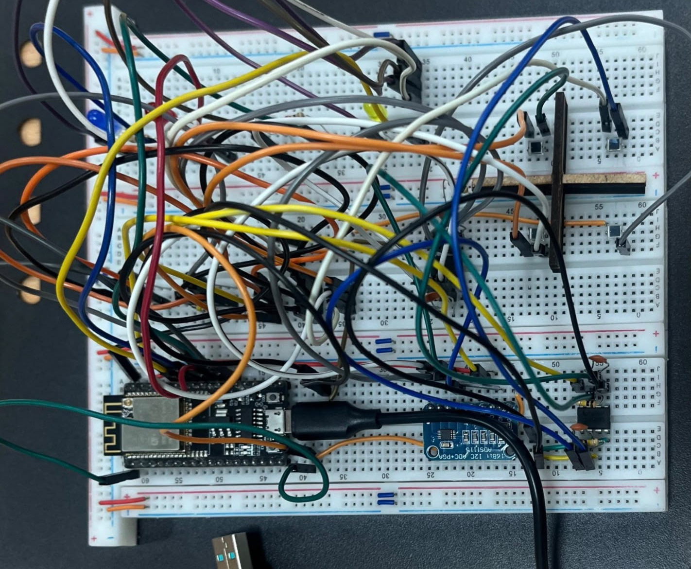
Breadboard connections

Slide 15
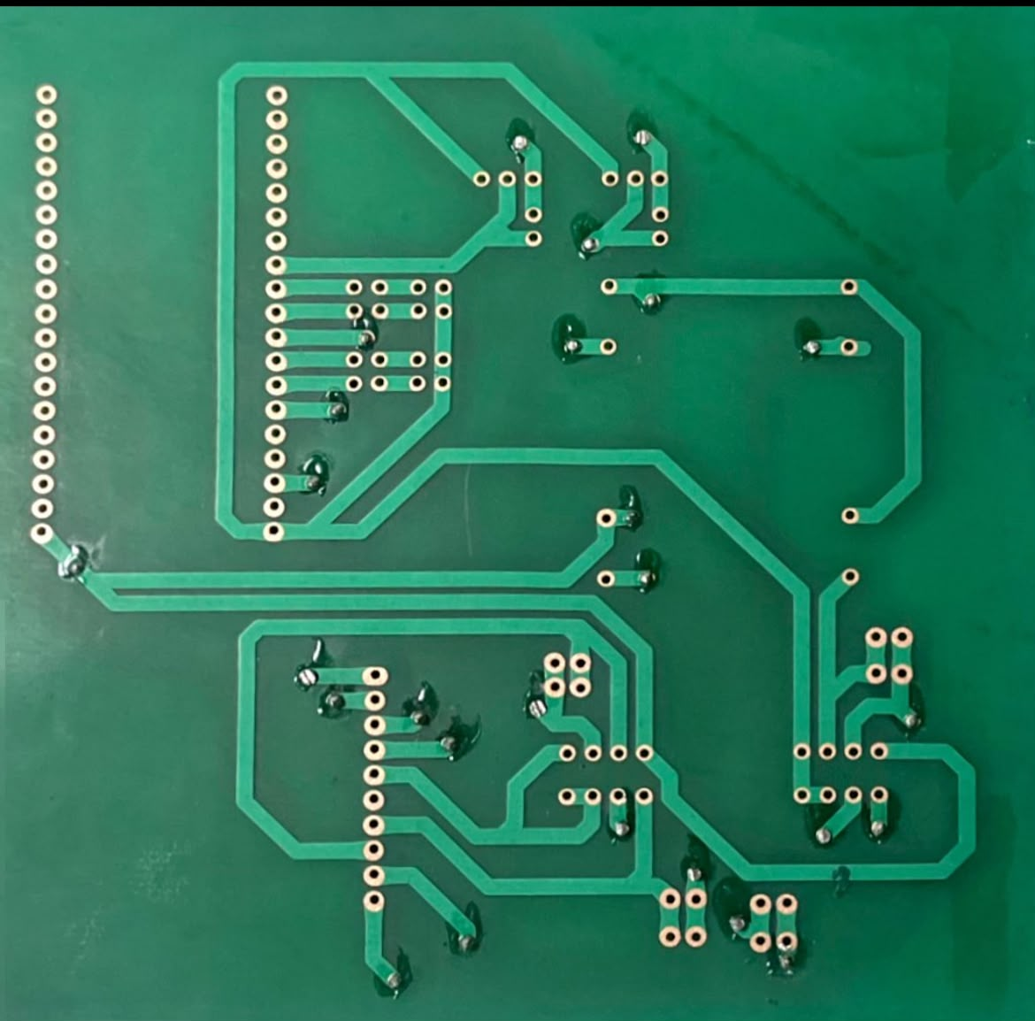
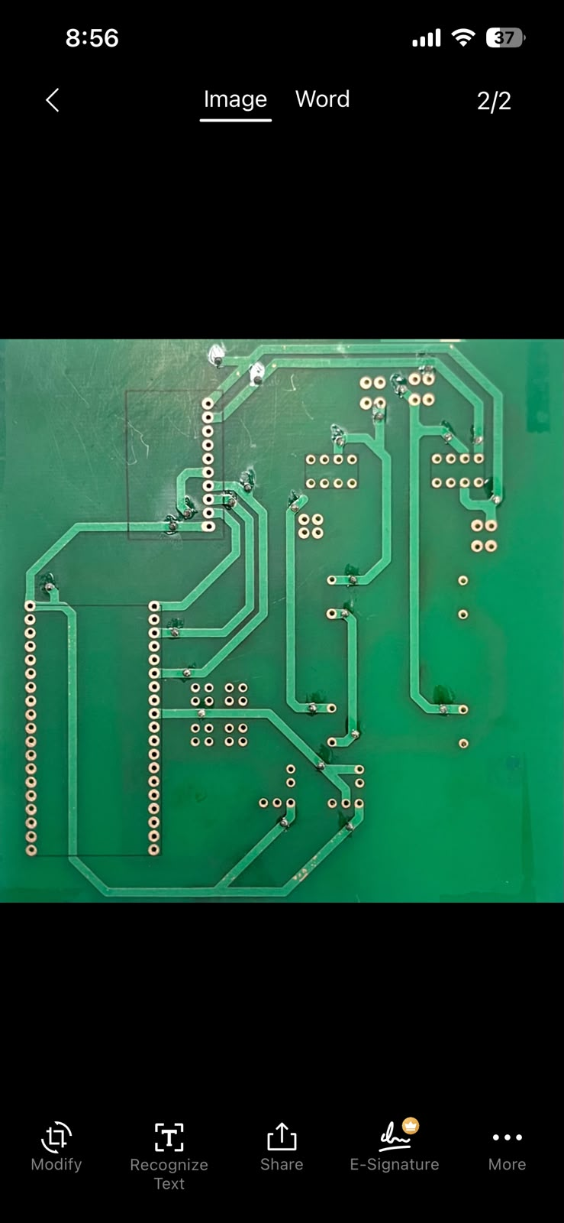
PCB Design
Two-layer PCB
(1)
(2)

Slide 16
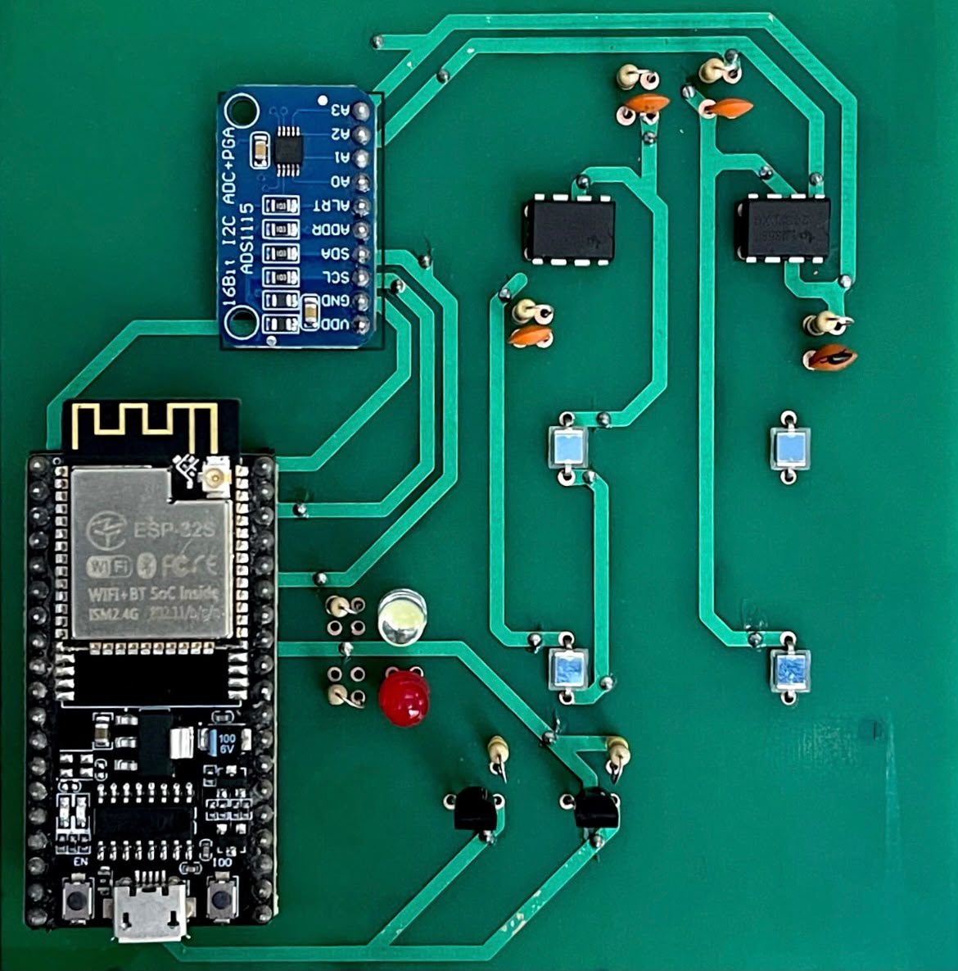
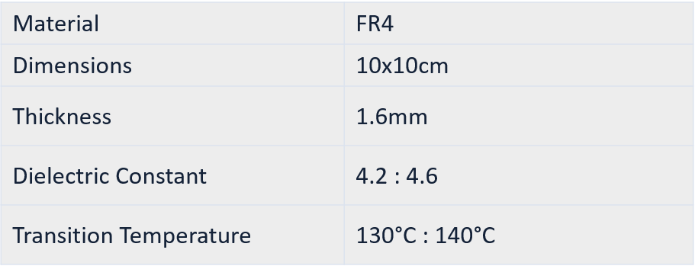
PCB Design
Grouping the analog signal path (photodiodes ,op-amps and ADC) close together to keep those traces short to reduce the noise since the generated signal is very weak.
Rounded corners to improve signal integrity since Sudden changes in trace geometry can create impedance discontinuities, which may introduce signal reflections and degrade performance.

Slide 17
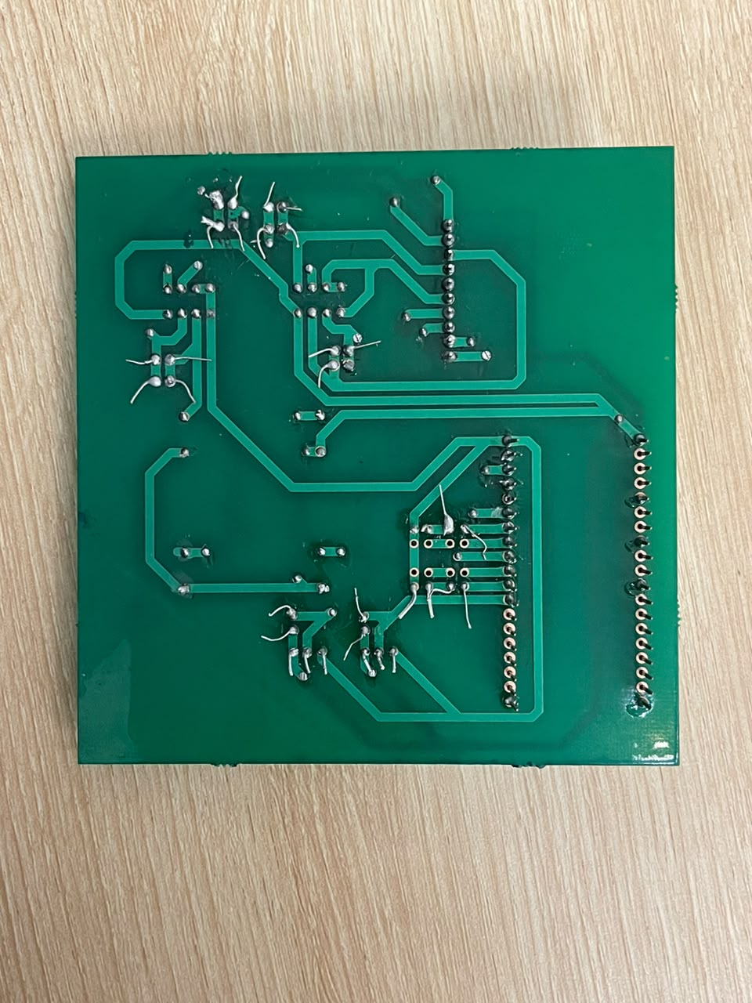
PCB Connections

Slide 18
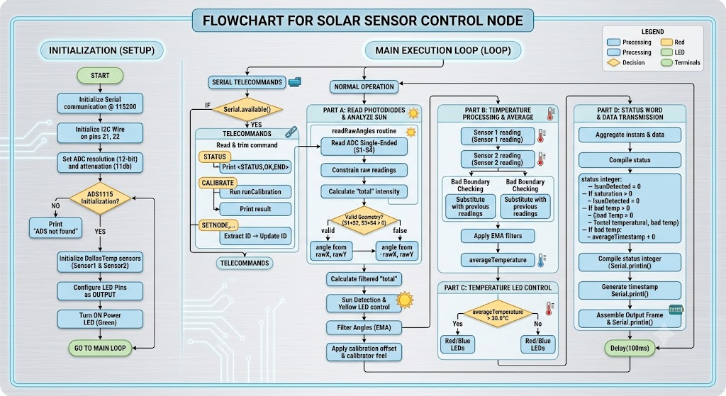

Slide 19
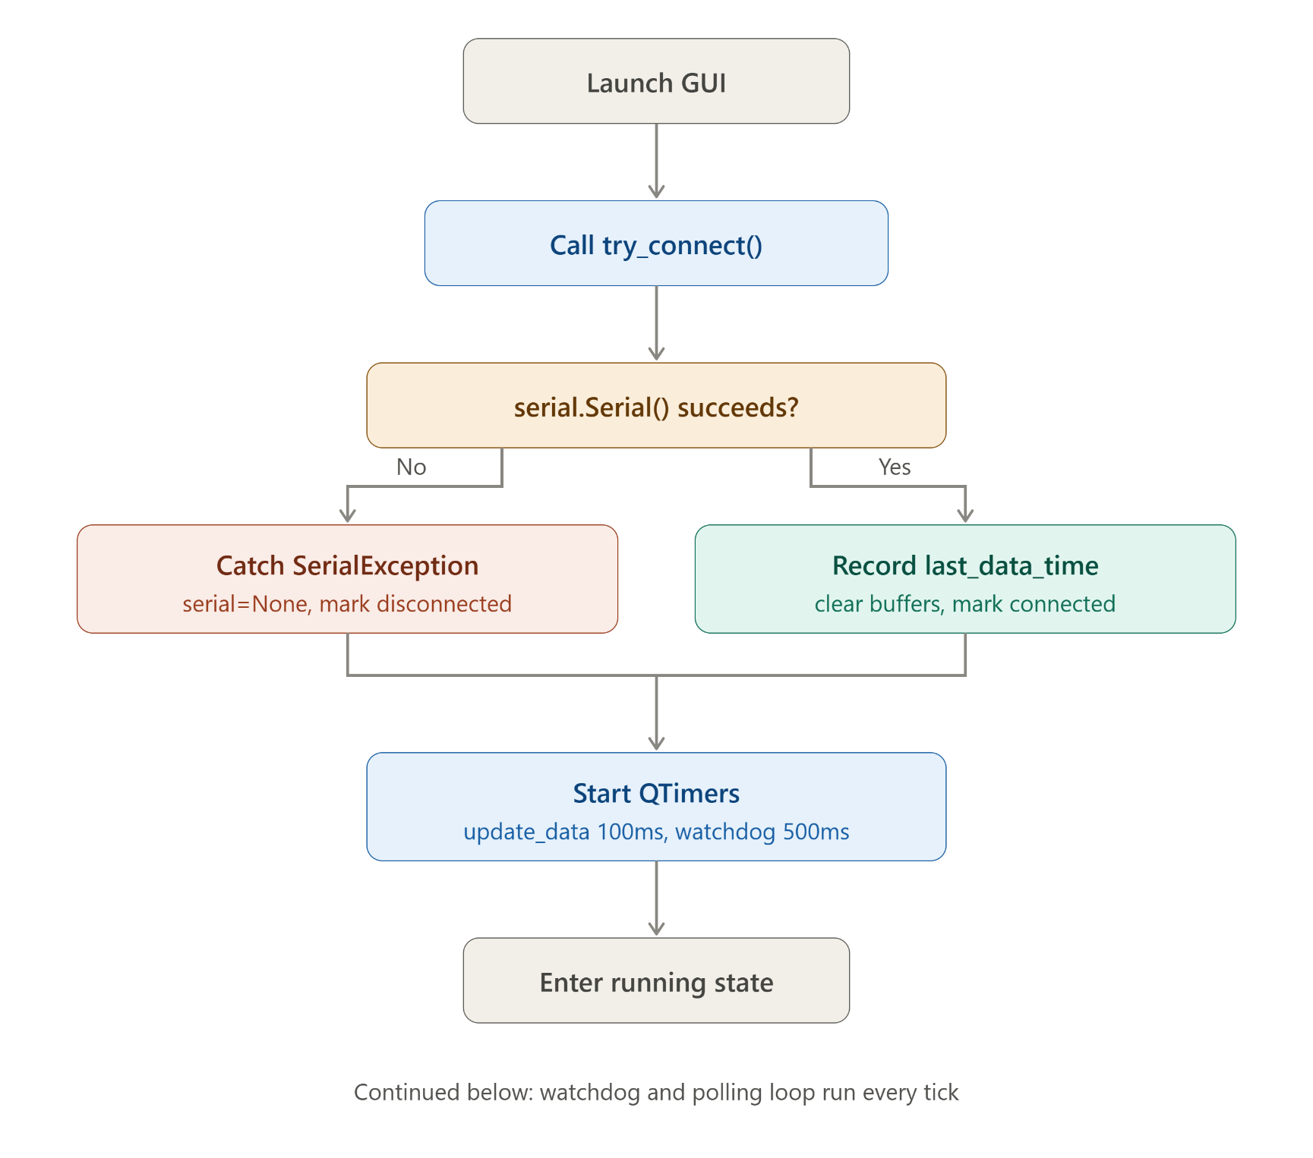
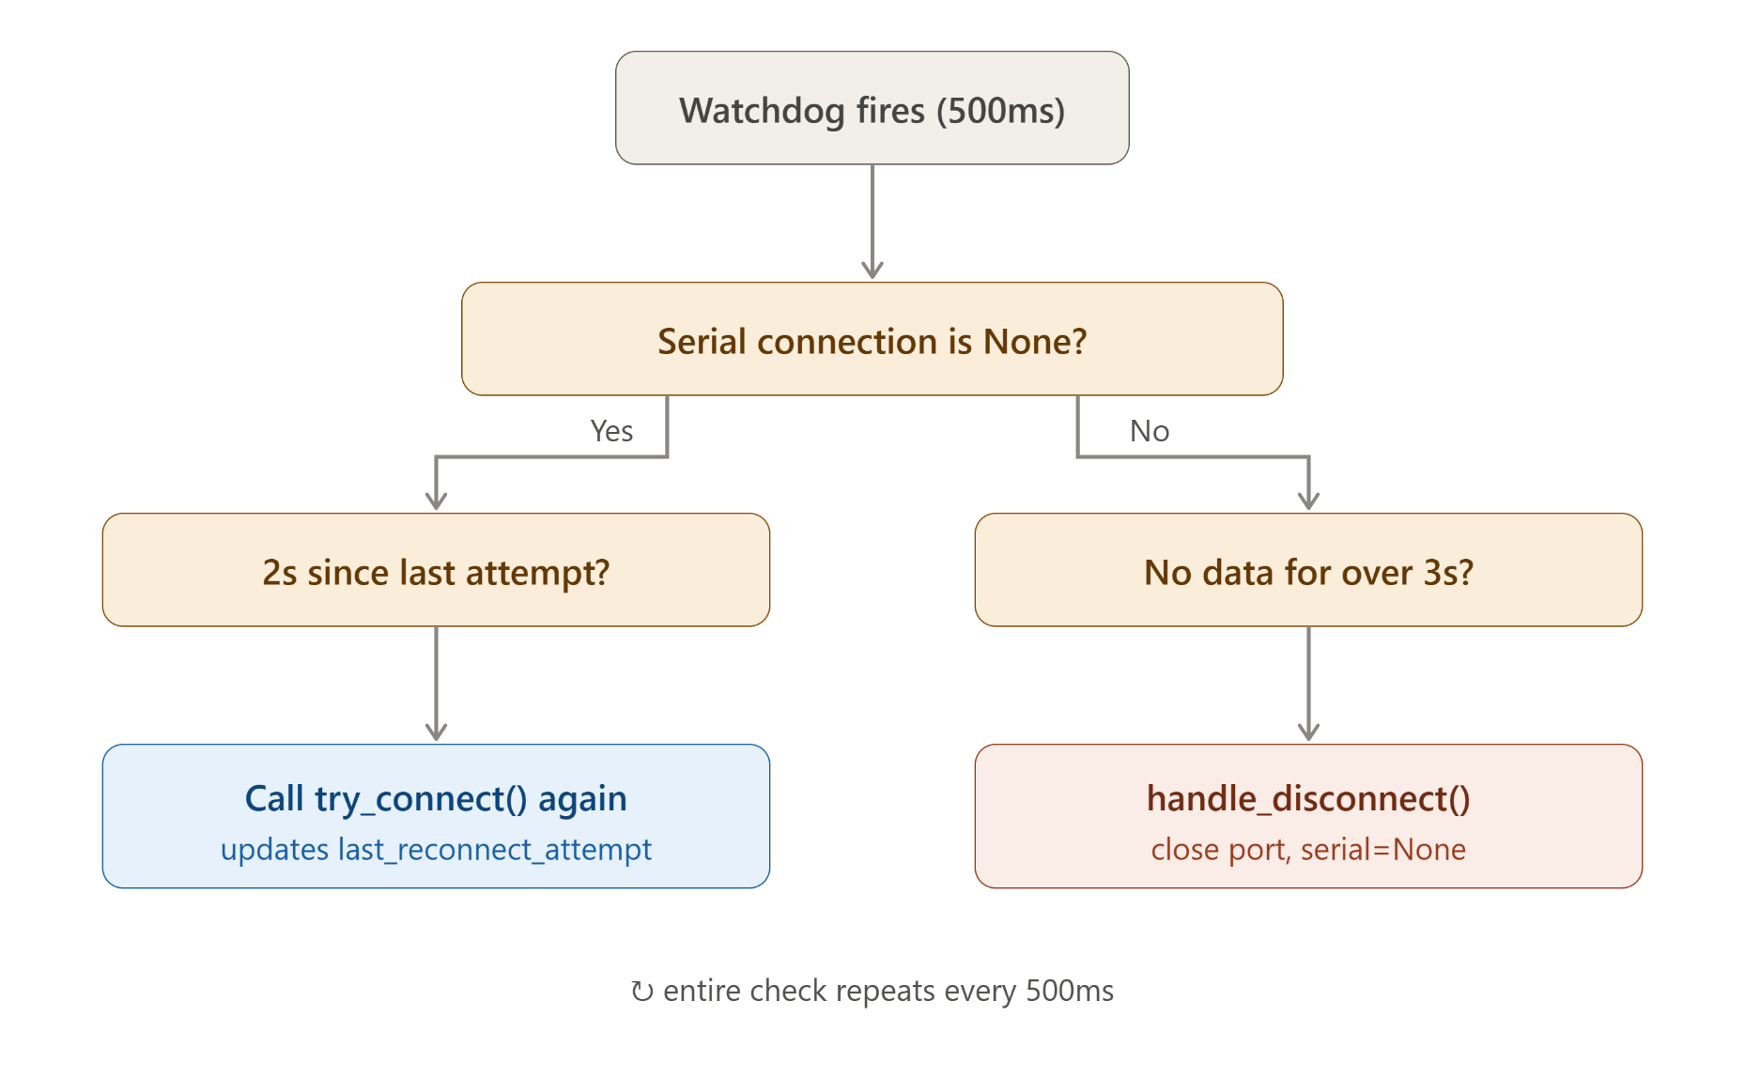

Slide 20
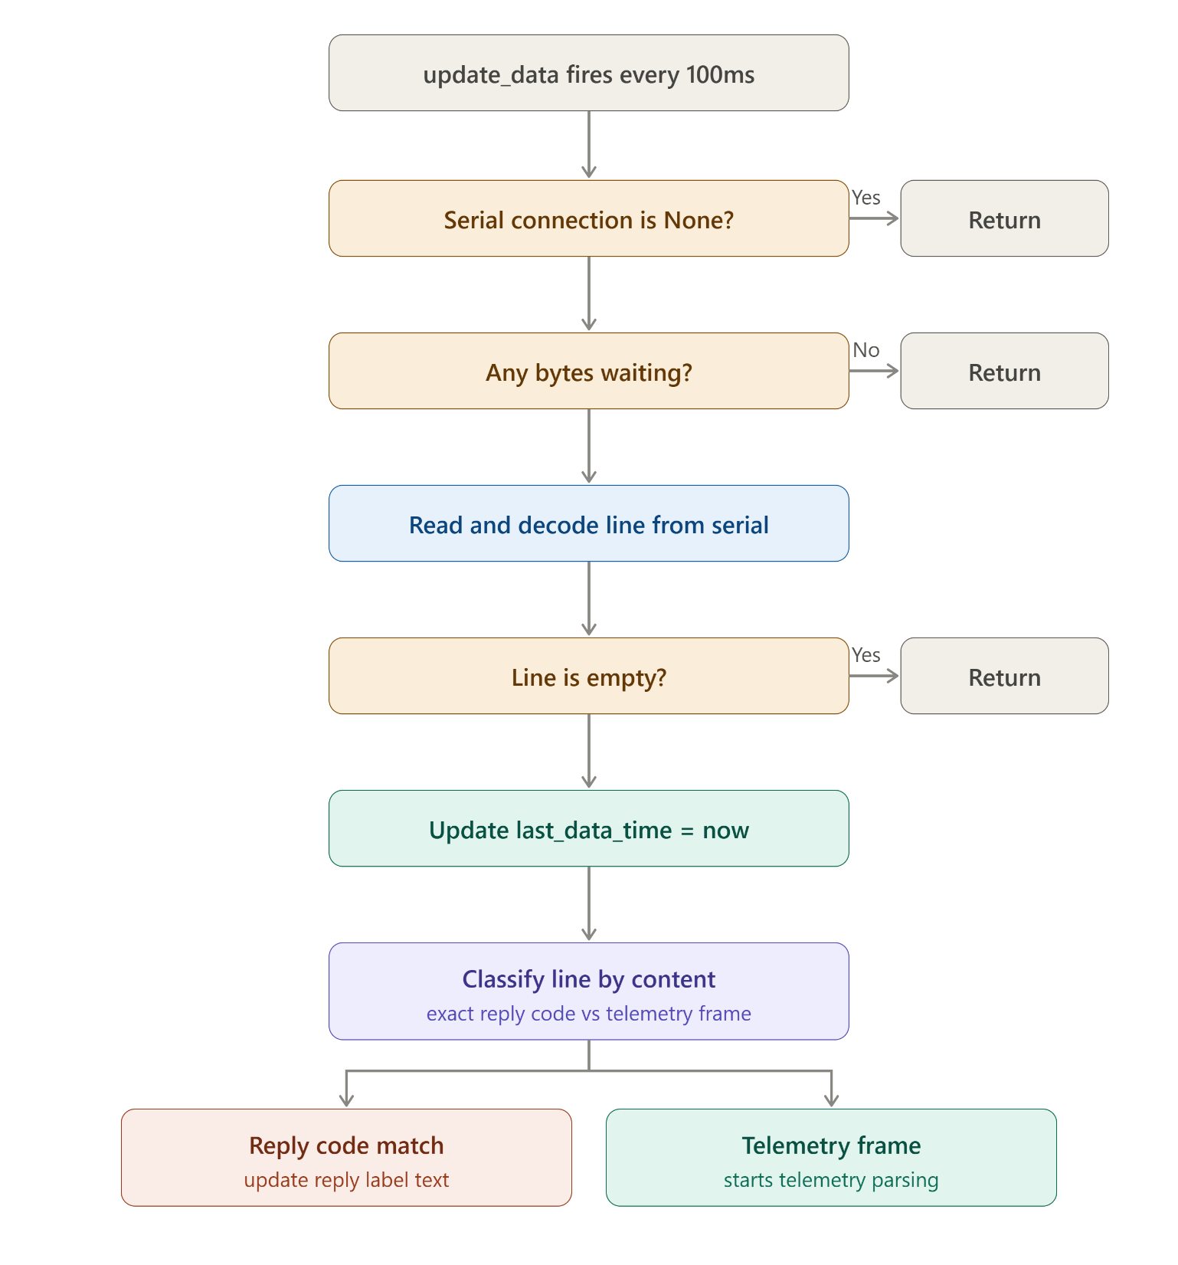
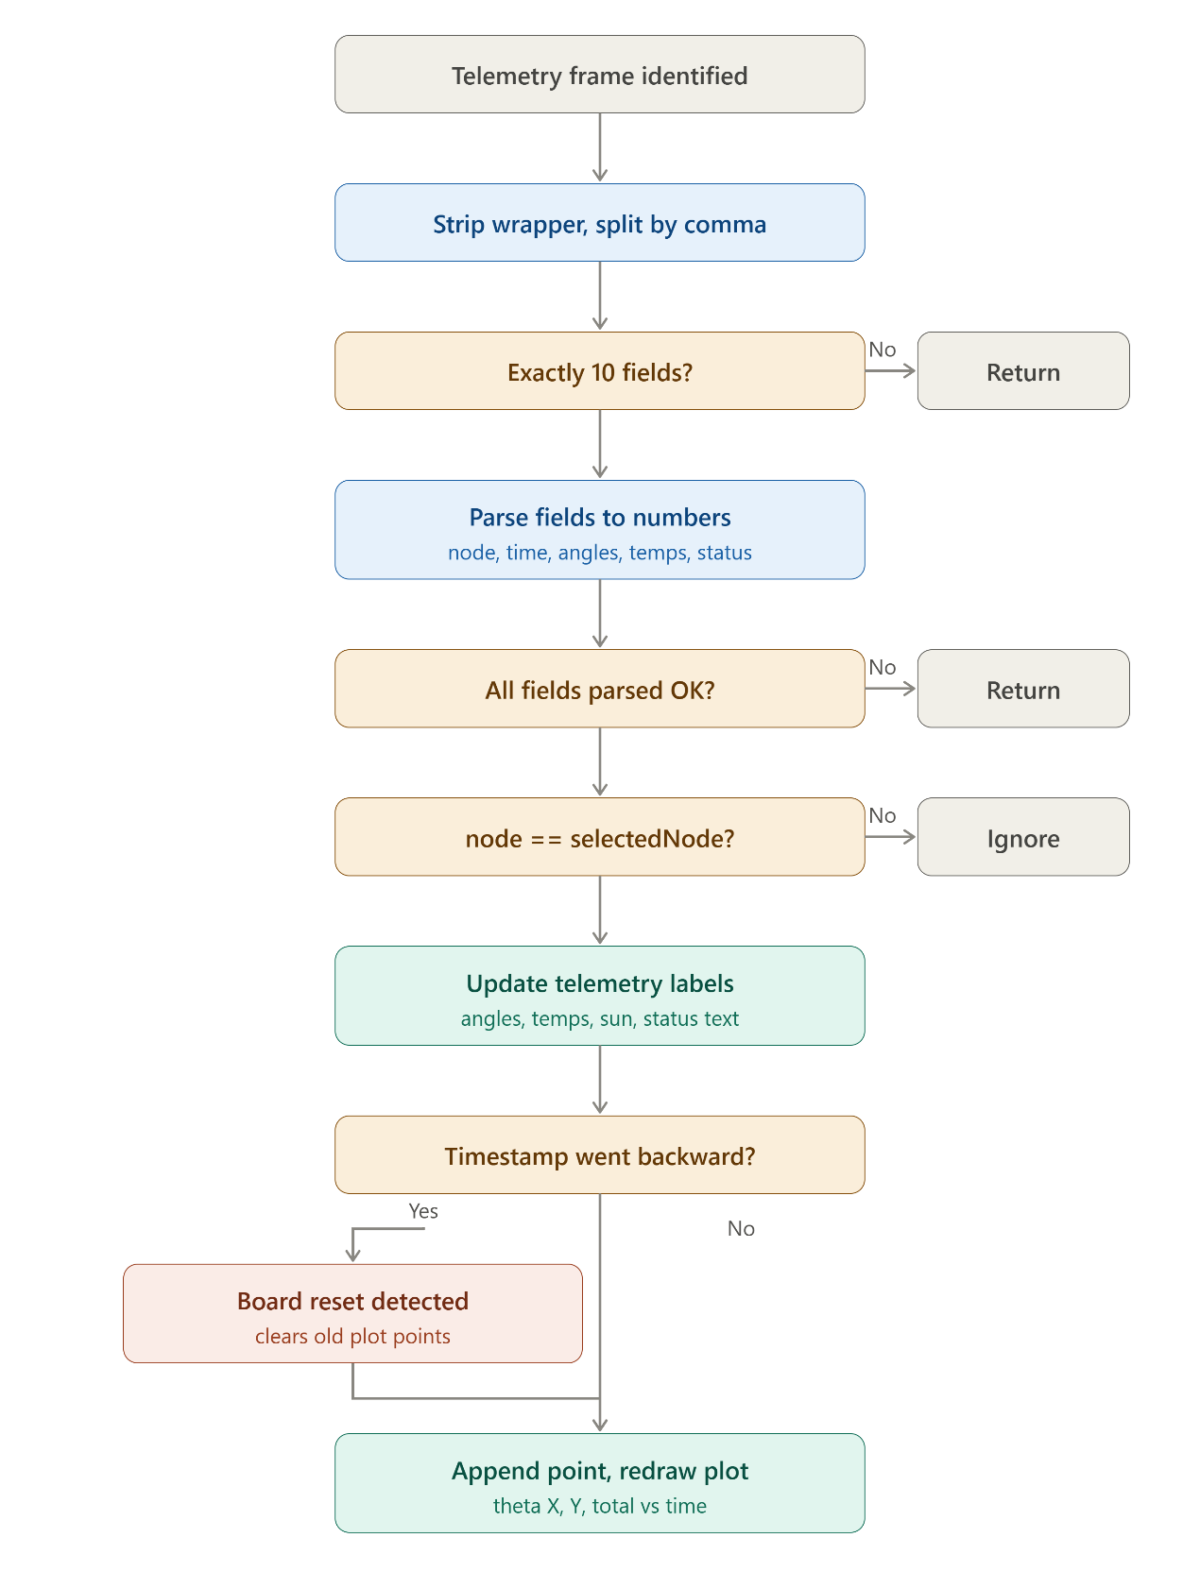

Slide 21
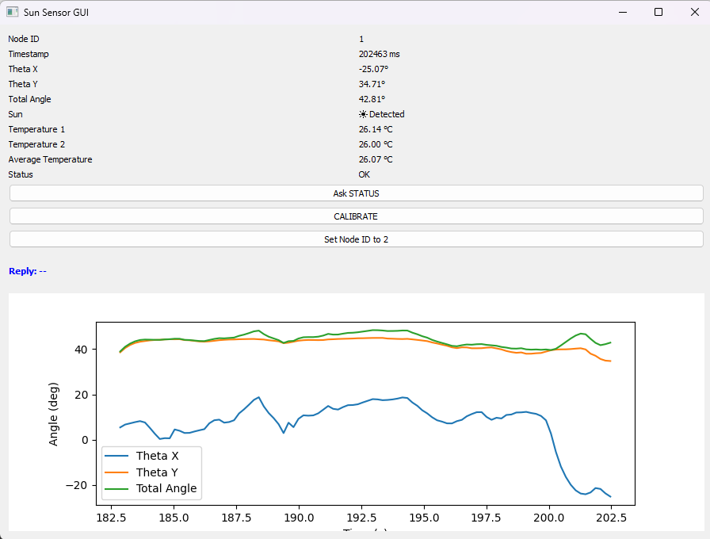
SOFTWARE · GROUND SEGMENT
Python Ground Control GUI
The ground-side GUI gives the operator a live window into subsystem health and sun-tracking performance during test and demonstration.
SUN DETECTED — Node ID 01
Coarse Sun Sensor CDR

Slide 22
Future trends
Improve angular accuracy through multi-point calibration.
Increase telemetry update rate above 10HZ.
Replace ESP32 with STM32.
Implement automatic self-calibration and temperature compensation.
Develop a more advanced GUI with 3D visualization and data export.
Conclusion
Successfully developed a functional Coarse Sun Sensor for satellite attitude determination.
Achieved real-time Sun angle estimation, Sun detection, temperature monitoring, and telemetry transmission.
Met the main competition requirements, including ≥5 Hz update rate and ≥±80° Field of View.
Delivered a reliable, low-cost, and scalable system suitable for CubeSat missions, with potential for future improvements.
Coarse Sun Sensor CDR

Slide 23
Thank you — questions welcome.
Coarse Sun Sensor CDR

